Slide 1

Systemic Risk Containment with Graph Neural Networks
Sofian Othmane 15th February 2025
Academic Supervisor: Prof Philip Treleaven

Slide 2
Research Motivations
The Complexity of Financial Markets
Modern financial systems are structured as highly interconnected networks where institutions are linked through interbank lending, derivative contracts, and cross-border exposures.
Traditional risk models, which focus on individual firm solvency, fail to capture emergent systemic behaviours arising from the financial network’s topology (Battiston et al., 2012)
2. The Nonlinear Nature of Financial Contagion and Shock Amplification
During crises, distress can spread through both direct exposures (e.g., loan defaults) and indirect channels (e.g., market liquidity evaporation) (Glasserman & Young, 2016).
The 2008 financial crisis and the 2020 COVID-19 shock demonstrated how feedback loops and second-order effects can trigger systemic collapses, necessitating better models that simulate these propagation mechanisms (Brunnermeier & Oehmke, 2013).
3. Policy Implications
By integrating GNN-based systemic risk analytics into stress testing frameworks, regulators can enhance their ability to identify high-risk institutions and implement pre-emptive interventions such as targeted liquidity support or capital injections (Glasserman & Kang, 2018)
2

Slide 3
Research Objectives
Develop a GNN-based framework to model systemic risk, capturing interdependencies and nonlinear contagion dynamics in financial networks.
Simulate financial shock propagation to identify high-risk institutions and measure the cascading effects of financial distress across the system.
Evaluate and optimise systemic risk containment strategies, testing interventions such as capital injections, liquidity support, and network isolation to mitigate financial instability.
3

Slide 4
Research Methodology & Structure
Graph Neural Network (GNN) Modelling of Systemic Risk
Financial institutions are represented as nodes, and their exposures (e.g., interbank lending, derivatives) form the edges of the financial network.
The implementation of Graph Convolutional Networks (GCN), Graph Attention Networks (GAT), and GraphSAGE to capture systemic interdependencies.
Shock Propagation and Contagion Simulation
Integrate DebtRank and Threshold Default Cascade models to simulate financial distress propagation.
DebtRank assesses the iterative impact of a node’s distress on others, while the threshold model captures tipping points leading to cascading failures
Evaluating Systemic Risk Containment Strategies
Capital Injections: Identifying optimal institutions for stabilizing the network.
Liquidity Support: Analysing the effectiveness of central bank interventions.
Network Restructuring: Evaluating the impact of isolating or restructuring high-risk institutions. Simulation results are validated against historical crises (2008, COVID-19) and benchmarked against conventional stress-testing models (Adrian & Brunnermeier, 2016).
4

Slide 5
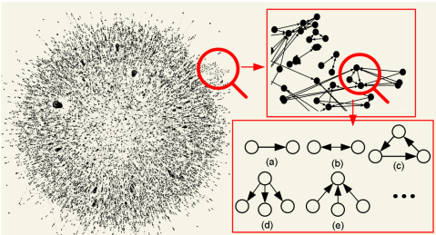
Experiment 1: Predicting Systemic Risk using GNN
Key Questions
Can a GNN-based model more accurately flag the institutions that pose the greatest systemic risk?
Does it better capture how risk propagates through the network structure?
Experiment
The first experiment assesses the effectiveness of Graph Neural Networks in identifying systemically important institutions and predicting systemic risk, in comparison to traditional models.
We set up a predictive task where the model must estimate each bank’s systemic importance or its risk level (for instance, probability of distress in a crisis, or a continuous risk score) based on pre-crisis data.
We define ground truth labels using an established systemic risk metric. One approach is to use ex-post outcomes: e.g., which banks actually required bailouts or had extreme losses in a stress period (mark those as high-risk), or use a metric like each bank’s SRISK or DebtRank score computed from data (treat top percentile as “systemically important”). This provides a target for the model to learn.
Graph Neural Network
Models
Baseline 1: Logistic Regression
Baseline 2: Random Forest
Graph Neural Networks:
GraphSAGE
Graph Convolutional Networks (GCN)
Graph Attention Networks (GAT)
Chen, Z., Wu, H., & Wu, Y. (2020)
5

Slide 6
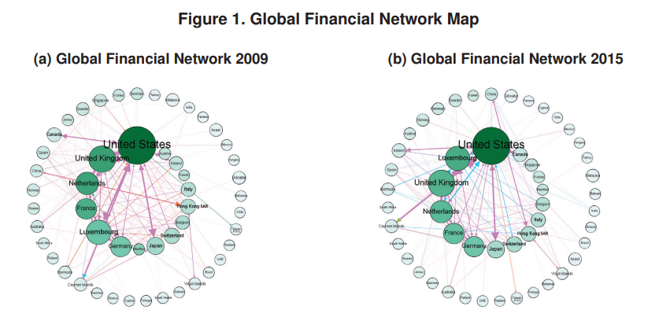
Experiment 2: Propagating Shocks in Financial Networks
Key Question
What are the key contagion pathways and tipping points?
Experiment
The goal is to compare our GNN-based predictions of distress propagation with classical contagion modelling techniques, assessing which approach better foresees the breadth and depth of cascade effects.
We simulate a range of scenarios where one or several institutions are "shocked" (e.g., suddenly incur a large loss or default).
For each scenario, we will trace the subsequent impact on other institutions over successive rounds (akin to time steps in a crisis unfolding). This is essentially a network stress test.
We aim to quantify key outcomes: how many banks become distressed or fail as a result of the initial shock (the size of the cascade), which specific banks are affected (the structure of the cascade), and what the total loss in the system is (aggregate systemic impact).
We will run the simulations under different assumptions about how contagion works to see which assumptions match reality or high-fidelity models. Specifically, we compare: (1) A DebtRank contagion model (linear incremental propagation), (2) a Threshold cascade model (discrete default triggers), and (3) a hybrid model combining elements of both.
Models
DebtRank (Linear Propagation Model)
Threshold Default Cascades
Hybrid Models: Combination of DebtRank and Default Cascades for comprehensive risk assessment.
Korniyenko, Y., Patnam, M., del Rio-Chanon, R. M., & Porter, M. A. (2018)
6

Slide 7
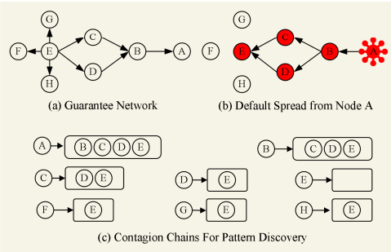
Experiment 3: Evaluating Containment Strategies
Key Questions
How effective are different containment strategies in mitigating systemic risk?
Which interventions (capital injections, liquidity support, network restructuring) best reduce contagion effects?
Experiment
In the third experiment, we turn to mitigation: given the contagion dynamics observed, we now test how various intervention strategies might contain or reduce systemic risk. The goal is to quantitatively assess the effectiveness of different policy measures in our simulation framework and identify which strategies best stabilize the system under stress. We specifically examine three types of containment actions, reflecting common crisis-management tools:
Capital Injections – providing additional equity capital to banks
Liquidity Support – providing short-term funding or asset purchases to banks/markets
Network Restructuring – altering the network by isolating or removing troubled nodes (or reducing exposures).
For each type, we design an intervention scenario and compare the outcomes with the baseline (no intervention) using the metrics from Experiment 2 (number of defaults, total losses, etc.). We use the same network and shock scenarios as before (e.g., a major bank failure or a system-wide asset shock) to see how outcomes differ under intervention. The GNN model is used to assist in these experiments as well: it can rapidly predict which banks are critical to save, or what the impact of an intervention would be, allowing us to try many configurations and then confirm with detailed simulation.
Chen, Z., Wu, H., & Wu, Y. (2020)
7

Slide 8
Data
Bank Financial Statements and Regulatory Data
This forms the core information for each node (institution) in the network. We need balance sheet and income statement data for banks, especially:
Capital Adequacy: Equity, Tier 1 capital, risk-weighted assets.
Asset/Liability Composition: Total assets, total liabilities, breakdown of assets (loans, securities) and liabilities (deposits, interbank borrowings).
Liquidity and Funding: Short-term funding amounts, liquidity ratios, cash reserves.
Interbank Exposures (aggregate): How much each bank has lent to or borrowed from other banks in total.
Other metrics: NPL (non-performing loan) ratios, provisions, etc. that might indicate risk.
Sources: A primary source for this is S&P Global Market Intelligence (SNL Financial) or Moody’s BankFocus (Orbis) – commercial databases that compile detailed financials for banks globally.
These datasets often have yearly or quarterly data for all major banks (public and many private). Public sources include regulatory disclosures: for example, the European Banking Authority (EBA) publishes a Transparency Exercise dataset (balance sheet and risk metrics for large EU banks) and results of stress tests.
Interbank Network Data
This is crucial for constructing the edges in our graph. Ideally, we want bilateral exposure data – who is exposed to whom and by how much.
This data is the most sensitive and typically not publicly disclosed except in aggregated forms
Regulatory datasets: In some jurisdictions, regulators have published anonymized interbank networks. For example, the ECB has published research using the EBA large exposure data, which is a matrix of significant interbank loans above a threshold (though not fully public, research papers sometimes include summary). The Bank of England and OFR in the U.S. have also studied interbank networks (e.g., using confidential supervisory data).
8

Slide 9
Contributions to Science (academic)
Advancing Network-Based Risk Modelling
This research provides a novel integration of network theory and machine learning, demonstrating how Graph Neural Networks can be applied to financial systems to improve systemic risk analysis.
Previous studies of systemic risk often took two separate approaches – network models using topological metrics or machine learning models using node features – but rarely combined both effectively
Insights on Financial Contagion
Our analysis of containment strategies (capital injection, liquidity provision, network isolation) in a controlled setting adds to academic understanding of macroprudential policy efficacy.
We also introduced the concept of using learned models to approximate contagion processes
using a tool like GNN in policy simulation is innovative – it suggests regulators could employ AI models to evaluate interventions quickly, a contribution to the emerging literature on algorithmic stress testing.
9

Slide 10
Impact Statement (business/industry)
Enhanced Risk Monitoring for Financial Institutions and Regulators
The GNN-based systemic risk framework offers a powerful early warning system for banks, asset managers, and regulators.
This allows proactive measures – a bank can reinforce its liquidity or reduce exposures, and regulators can engage in supervisory dialogue or targeted inspections
By integrating it into risk management dashboards, financial institutions can better anticipate counterparty failures or market shocks.
Improved Crisis Management
The containment strategy analysis we performed can guide institutions and authorities on “where to pull the levers” in a crisis. For instance, a central bank or finance ministry can use our model’s output to decide whether injecting capital into a certain bank will stabilize the system or if providing liquidity to the market would be more effective.
Resolution authorities (who manage failing banks) could employ our network model to ensure that when they wind down a bank, they do so in a way that minimizes contagion (perhaps by pre-emptively shoring up key counterparties of that bank).
10

